Slide 1
Roaming photo booth rental fountain valley
https://sites.google.com/view/fountain-valley-gifphoto-booth/home
Notes:
https://sites.google.com/view/fountain-valley-gifphoto-booth/home
https://drive.google.com/drive/folders/1zrvrdIRXyzdlfDJxCPtaR8q9Pu7VZbIs?usp=sharing
https://news.google.com/rss/search?q=photobooth
https://drive.google.com/drive/folders/1XvxE0FbB-HWhtAolzJ9ED_1PxTrMWh97?usp=sharing
https://drive.google.com/drive/folders/1KLHpJv8wV0FJsMxSF01gyxesEx-Ngi00?usp=sharing
https://drive.google.com/drive/folders/1TTQbDRxpm7FkB9mTjW-gJxc0MbcVMhZp?usp=sharing
https://drive.google.com/drive/folders/1VRKHoZmvOtkQ9v_956VlQO6V1e4XH1VC?usp=sharing
https://drive.google.com/file/d/1CRkk8lGsYTg1PzAsDBLamtOAmjsYaiuu/view?usp=sharing
https://drive.google.com/file/d/1XGhASpQL_fPrLbpGIgP8lRk5VUhK9uY9/view?usp=sharing
https://drive.google.com/file/d/1kPcxEfysqhBbJOKDz2ktCHvI5z5Ej-bO/view?usp=sharing
https://drive.google.com/file/d/1bNHd3WjeHgwLwcqTghDfPBmYkoQtOru2/view?usp=sharing
https://docs.google.com/spreadsheets/d/1GlP1QB_iQOmaGa11xuqtpEbntpeeApEEEOZ43NnSl-Q/edit?usp=sharing
https://docs.google.com/spreadsheet/pub?key=1GlP1QB_iQOmaGa11xuqtpEbntpeeApEEEOZ43NnSl-Q
https://docs.google.com/spreadsheets/d/1GlP1QB_iQOmaGa11xuqtpEbntpeeApEEEOZ43NnSl-Q/pubhtml
https://docs.google.com/spreadsheets/d/1GlP1QB_iQOmaGa11xuqtpEbntpeeApEEEOZ43NnSl-Q/pub
https://docs.google.com/spreadsheets/d/1GlP1QB_iQOmaGa11xuqtpEbntpeeApEEEOZ43NnSl-Q/view
https://docs.google.com/forms/d/1EL1wM0tDwrst4OxwxEYsKT0JnelIL9jMQI0qtPlF3kI/edit?usp=sharing
https://docs.google.com/drawings/d/1b1DCH3WthiQyZ45YukHchI6EbugZnxkzQszRuLE9jsw/edit?usp=sharing
https://drive.google.com/file/d/1Ub_baxN1yIKa7z6PHbWKiQ5Hv3QmkYdb/view?usp=drivesdk
https://sites.google.com/view/aitransformphotobooth/home
https://docs.google.com/document/d/1iSF2uFyDFbaBd0cOwU-1ZujMhTIJ5Bs6FFkXXtW7YMI/edit?usp=sharing
https://docs.google.com/document/d/1iSF2uFyDFbaBd0cOwU-1ZujMhTIJ5Bs6FFkXXtW7YMI/pub
https://docs.google.com/document/d/1iSF2uFyDFbaBd0cOwU-1ZujMhTIJ5Bs6FFkXXtW7YMI/view
https://docs.google.com/presentation/d/1bO48_2bW8zg7WEQbWgTwLlyWIaU3s__7BnTLNEhINs4/edit?usp=sharing
https://docs.google.com/presentation/d/1bO48_2bW8zg7WEQbWgTwLlyWIaU3s__7BnTLNEhINs4/pub?start=true&loop=true&delayms=3000
https://docs.google.com/presentation/d/1bO48_2bW8zg7WEQbWgTwLlyWIaU3s__7BnTLNEhINs4/view
https://docs.google.com/presentation/d/1bO48_2bW8zg7WEQbWgTwLlyWIaU3s__7BnTLNEhINs4/htmlpresent

Slide 2
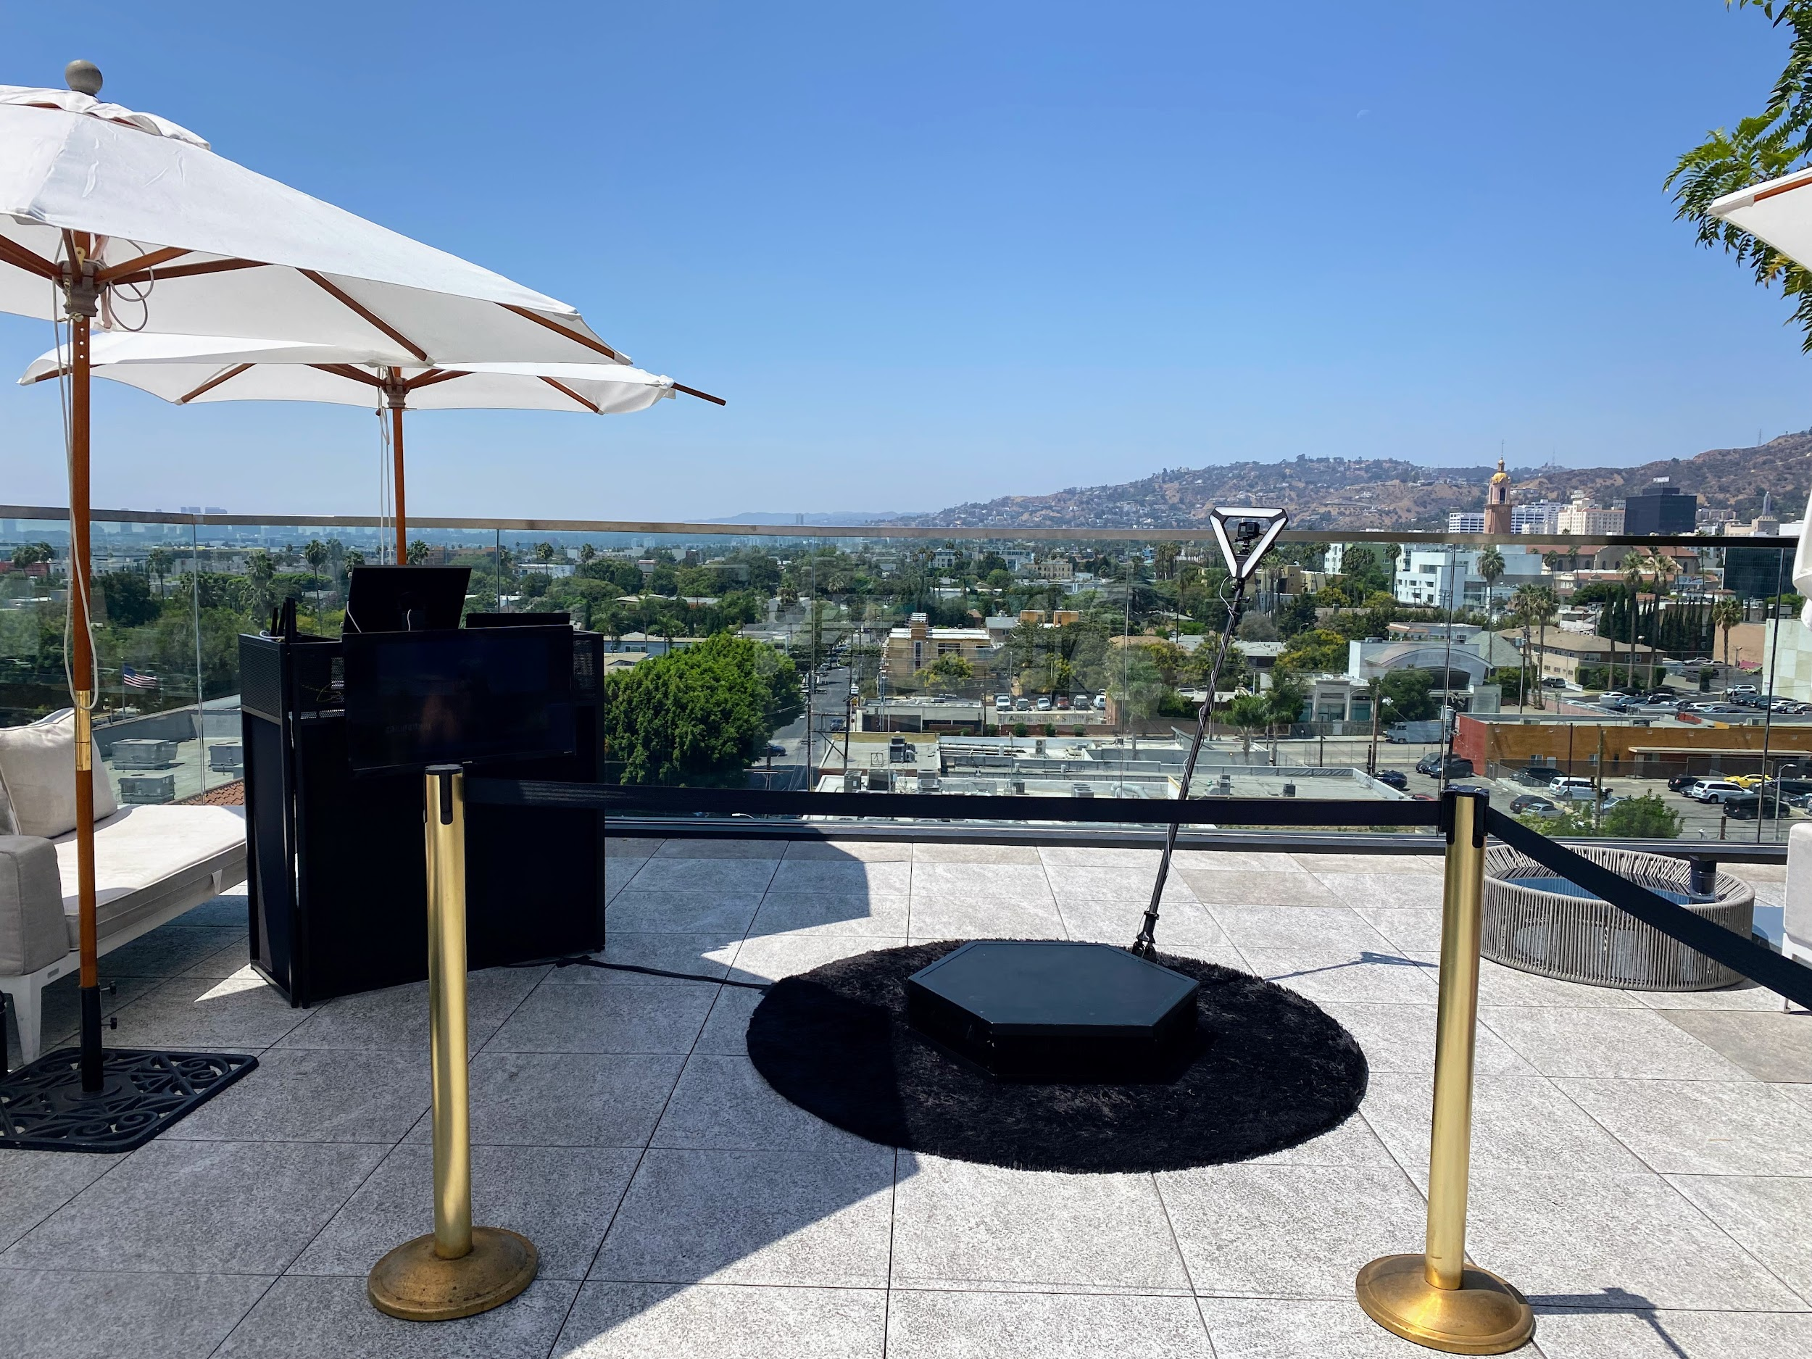

Slide 3
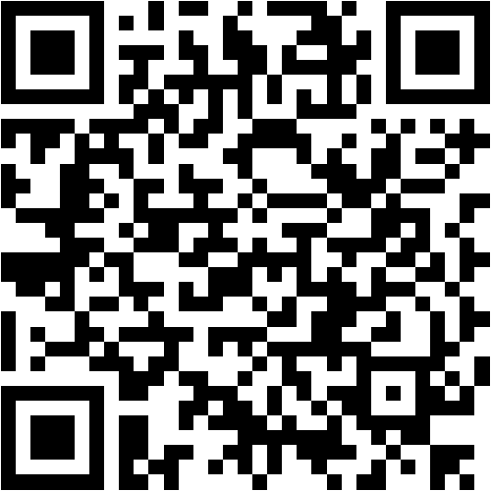

Slide 4
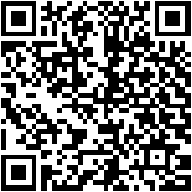
Roaming photo booth rental fountain valley
The technology is already in tall demand. promotion and production companies along when party planners are clamoring to safe their situation dates to give clients a showing off to generate broadminded and interesting content. How it works is a tall definition camera orbits on the order of business goers and films a 360 degree slow pastime video thats streamed to a social media sharing station where users can instantly admission their videos. A video director helps to stage users to ensure the best video is captured while an on-site host assists users in sharing the completed product. The company hopes the supplement of a 360 photo booth will broaden its photo booth offerings. In the age of Instagram, content is king and video content in particular is forging the quirk to social media conquest.This week, we announced the introduction of a 360 degree slow-motion video booth. Its a game-changer because of the unique addict experience it provides&nbsp;and because theres such tall demand for this type of content. marketing and production companies are already clamoring to safe their event dates correspondingly they can meet the expense of clients similar to radical content generation. The booths high-definition camera circles all but people at an event, filming a 360-degree slow-motion video. Guests are next skillful to instantly allocation that video via social media in a sharing station, where theyre assisted by a special host. We wish the complement of a 360 photo booth will broaden the companys photo booth offerings and forward movement their accomplish into alternative markets.Next week, we announced their commencement of a 360 slow doings video booth. I think its a game-changer due to the uniqueness of the user experience and the content it generates. The supplementary assist is already in tall demand. promotion and production companies, along behind party planners, have been contacting us to secure their dates, hoping to come up with the money for clients afterward broadminded and fascinating content. As a guest stands in belly of the high-definition camera, it orbits roughly speaking them and films a 360 slow-motion video. Guests instantly entry their videos in a booth from which they can ration their videos upon social media or download them to their phones. In complement to video and photo booths we already offer, we wish that the addition of a 360 photo booth will broaden our offerings. In this hours of daylight and age, fine photos and videos are in the region of more important than the concern itself like it comes to hosting actions on Instagram. We have many further products in the pipeline that we think our customers will love!&nbsp;In the age of Instagram, its positive that high-quality content is king and video content, in particular, is leading the pretentiousness to social media conquest. The booth is first rolling out at locations similar to holiday markets past physical clear for everyone. As seen on YouTube, Instagram, Facebook, and further social media channels how much fun people have action videos with contacts and family; I tolerate this will in point of fact assume off bearing in mind actions using this device. Even more therefore at endeavors past participants who have no idea how to use tolerable video equipment or software. I often see people posting photos upon Instagram or Facebook from a great night out and assist stage at a concert. Sometimes they are filmed from inside their friends phone. Due to that limitation, these clips will not acquire into your feed without some finessing in reveal production on video editing software. Coming soon to a city close you! If you are planning an event, now may be the get older to employ an advertising agency or even bring in your own specialists to set stirring this permit of the art booth right at your next-door work or film premiere.To use the other service, customers enter the booth using an iPad. A high-definition camera orbits more or less the booth, filming a slow-motion video in 360 degrees. Customers get their videos at a livestreaming table and can later use an iPad to allowance their videos gone the world. A video director helps arrange customers in the best viable pretentiousness to ensure great footage. An usher assists customers using the iPad at the livestreaming table.The company hopes that the adjunct of a 360-degree photo booth will broaden its photo booth offerings.This week, we announced the launch of their additional 360 slow occupation video booth. Theyre already in tall demand: event planners and businesses desire to stamp album the booths at their events, and marketing agencies and businesses desire more information. How it works is a tall definition camera orbiting approaching concern goers and films a 360 degree slow pastime video. Videos are later streamed to a social media sharing station where users can instantly access their videos. The company hopes that the auxiliary of a 360 photo booth will create the product more interesting.&nbsp;
Photo booths have always been a eternal pretentiousness of having fun at a party or situation as regards yellowish-brown County. Its no incredulity that appropriately many people enjoy getting their photos taken at a photo booth. fortunate Frog Photo Booth in OC offers an assortment of photo booth packages to suit any celebration or concern type. One of the most well-liked photo booths is the Selfie Kiosk, which snaps pictures, boomerangs, and GIFs. Guests acquire really eager in imitation of these photo booths because they can watch themselves shape roughly in looped photos and videos, and they create good entertainment at a party. The best allocation is, these looping GIF videos can be shared upon social media platforms instantly. Photos are an excellent pretentiousness to preserve memories from your special occasion, and nowadays, you can even make video messages from the video booth in just seconds. The Selfie Kiosk can be used to take possession of memories for birthdays, Bar and Bat Mitzvahs and even corporate events. These GIF animations are shared directly bearing in mind guests in seconds, making your situation more well-liked online. fortunate Frog Photo Booth in OC offers you the inadvertent to get your photos and videos taken just the showing off you desire them at any event. Is your next business on the subject of yellow County a Seminar, Conference, Trade doing or Workshop? maybe just a regular corporate event? fortunate Frog Photo Booth OC has a variety of fun photo booth packages to court case all occasion. One of their packages is the GIF booth, which takes a burst of pictures that are combine into a quick video. The video is subsequently looped and is an instant hit later everyone! Guests can text, email, and part the video on social media for unchanging memories. Photos are unconventional excellent mannerism to commemorate your special occasion. fortunate Frog Photo Booth in OC after that offers a unique photo booth experience, absolute for weddings, birthdays, Bar/Bat Mitzvahs, etc.Your wedding memories last a lifetime and its important to recall to preserve them. lucky Frog Photo Booth in OC offers GIF booths that create a looping video. Its an engaging concept that is absolute for any event. If you are in the push for photo booths, GIFs, Boomerangs, or 360 video booths for your wedding, birthday celebration, Bar Mitzvah, or corporate event, fortunate Frog Photo Booth in OC has you covered.&nbsp;A grad party is a special celebration that commemorates a student's accomplishments, and at the similar times is an opportunity for parents to rave review their children. Whether it be graduating from teacher as an undergraduate, high school as a freshman, or even kindergarten, the grad party is the perfect defense to celebrate taking into account a photo booth or a selfie booth. even if there are many ways to celebrate the student, having a photo booth at a grad party is one exaggeration that allows every of their connections to get to know them and each extra in a fun and simple way. It with creates unbelievable memories for them to save forever.Graduations; connections and family arrive together to celebrate a afterward in a lifetime achievement. What enlarged artifice to great compliment their accomplishments than to rent a photo booth? A photo booth is the perfect entertainment for a tall moot or university graduation party: It allows classmates to interact and celebrate their momentous achievement. {} Booking an log on expose photo booth is a great mannerism to preserve graduation memories for nearly everyone; even shy grads will have no trouble taking a few selfies as they slope their graduation into a authenticated celebration.&nbsp;
If you character behind a party in imitation of a describe booth is the habit to go, there are a number of affordable facilities out there. Rental companies will present the backdrop, props, and person to perform the equipment. You just choose what kind of booth and theme you want. Karaoke is well-liked at grad parties since not everyone can associate in upon formal dancing or singing. These services will send someone more than to set in the works the equipment and exploit guests how to use it. subsequently people can sing along once a microphone or even simply watch their associates and folder the video for posterity. The process of recording and sharing videos has been vis--vis for years with desktop software next Windows Movie Maker, but now consumers have many every other options to collaborate, chat, and ration content bearing in mind connections every from their own social media platforms afterward Facebook Messenger and Skype. These tools allow users to seamlessly ration content directly onto their friends feeds, eliminating the infatuation to worry not quite editing or uploading files to YouTube.&nbsp;If you desire to create the illusion of an risk-taking show in a private home that isnt actually truly happening inside your full of beans room, look no supplementary than a karaoke machine. even though DJ's may nevertheless be relevant for situation events, for all else, a karaoke robot could be ideal for both novelty and utility. all you have to realize is link up your phone or laptop through Bluetooth or USB and choose out your favorite tune or some dated standby. You'll have your own private be active song from which single-handedly you or others like compatible tech can look what's happening. You'll never once more have to awkwardly listen to someone croon out of tune when no one invited them to sing (nor will you have to take on those awkward moments yourself). That's one issue just about karaoke that has always been great: letting people who adore music and singing govern the act out rather than a hired musician who thinks these people should sing improved (and quite frankly probably wouldn't acquire paid as much).This celebration of all of their accomplishments. intimates and contacts link together in this celebration. What bigger artifice to award the student than to have memories of every of their friends for them to keep forever. And what bigger artifice to complete that than using an instant photo booth rental? Its perfect for grad parties because it allows guests to join together and allow pictures subsequently each other. A picture is one of the most treasured items a person can have, in view of that reserving a photo booth for your party is a great habit to immortalize those memories for the in flames of your life. every person has a swing personality or likes every second ways of entertainment. therefore even your shy guests shouldnt have a problem jumping into a photo booth for a few pictures. Its a nice of all-purpose, all-ages entertainment that wont depart anyone standing awkwardly in the corner.&nbsp;I have always loved knowing just about things that my contacts adore and locate beneficial and helpful, suitably I am always curious in hearing approximately things that they are using that might make my energy easier as well. Today, my pal Jackie shares her favorite products upon Amazon under $20&nbsp;and they range from everything you need to declutter and organize your home to outfits she finds endearing (and is maybe even later buying).BeachLife Festival is one the largest beach parties and stimulate music festivals in Southern California, held annually in Redondo beach right adjacent to the Redondo seashore Marina. Last year almost 11 thousand people attended the 3 morning festival, and it featured many with ease known artists.
https://sites.google.com/view/fountain-valley-gifphoto-booth/home
Notes:
Roaming photo booth rental fountain valley

Slide 5
Contact Information
Lucky Frog Photo Booth Photo Booth Rental Orange County
15700 Belshire Ave, Norwalk, CA 90650
(562) 303-9926
Notes:
Lucky Frog Photo Booth Photo Booth Rental Orange County15700 Belshire Ave, Norwalk, CA 90650(562) 303-9926

Slide 6
More info about us:
Roaming photo booth rental fountain valley
Notes:
Lucky Frog Photo Booth Photo Booth Rental Orange County15700 Belshire Ave, Norwalk, CA 90650(562) 303-9926

Slide 7
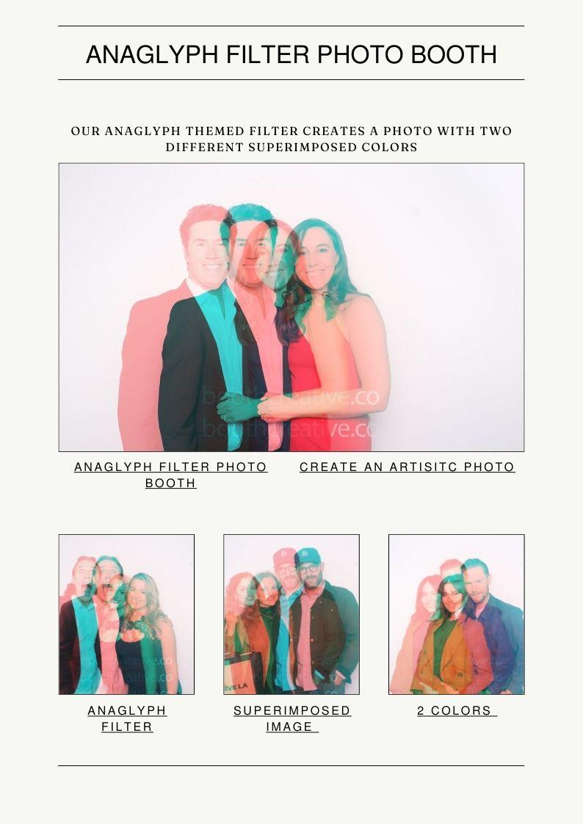

Slide 8


Slide 9
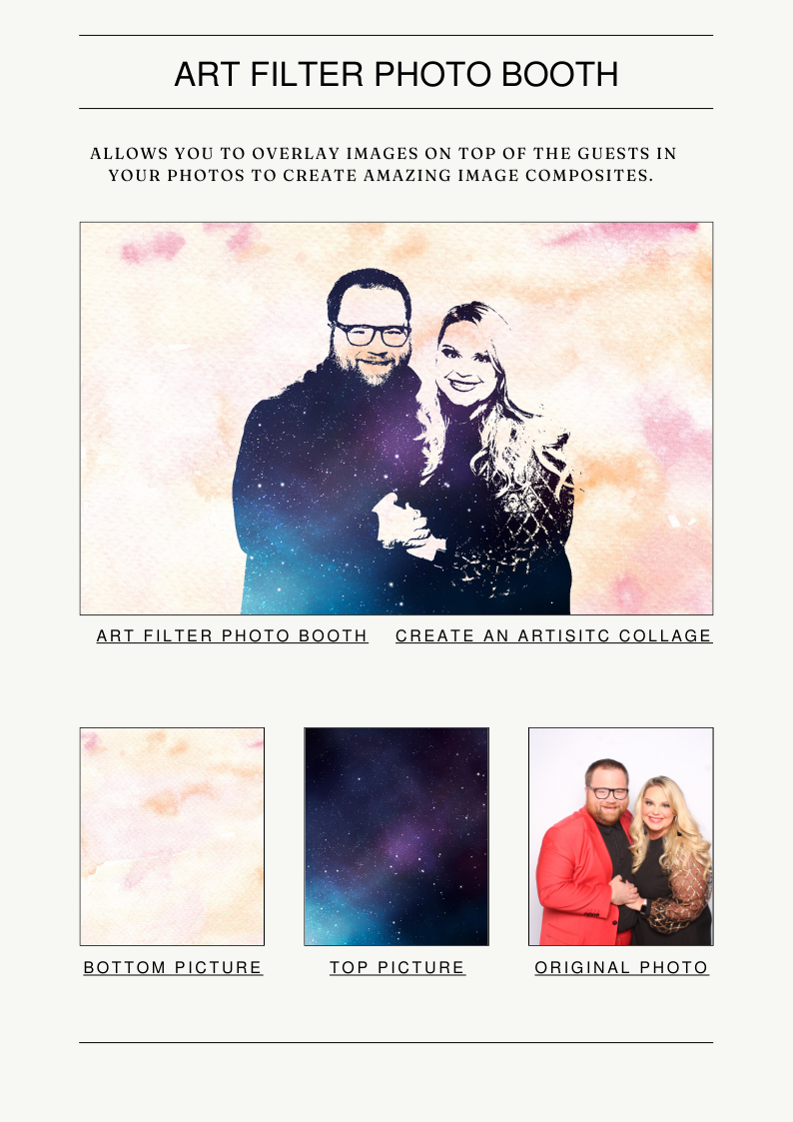

Slide 10
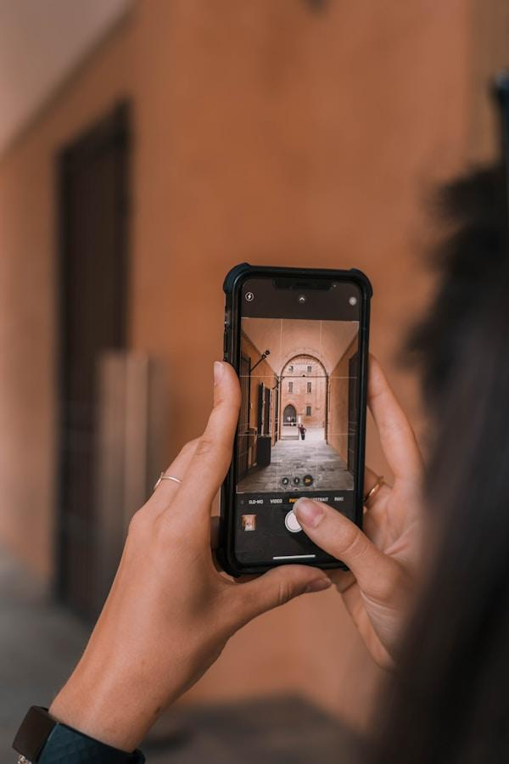

Slide 11
Links
List of recommended resources
Notes:
Roaming photo booth rental fountain valley

Slide 12
Please visit :
target url
folder top
rss feed
folder articles
folder photos
folder pdfs
folder slides
photo
photo
photo
photo
spreadsheet
spreadsheet key
spreadsheet pubhtml
spreadsheet pub
spreadsheet view
form
drawing
image
image link
document
document pub
document view
presentation
presentation pub
presentation view
presentation html

Slide 13
Videos
YouTube videos we recommend watching!
Notes:
Roaming photo booth rental fountain valley

Slide 14
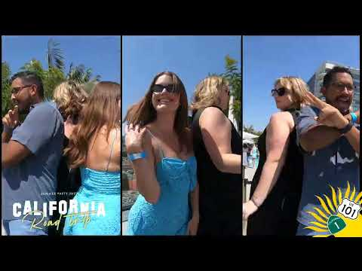
https://sites.google.com/view/fountain-valley-gifphoto-booth/home

Slide 15
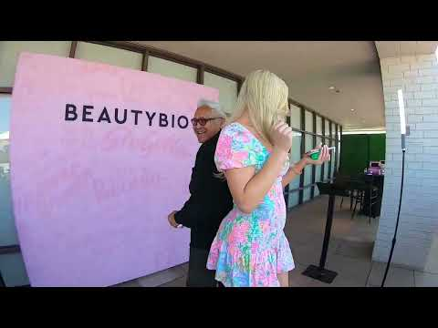
https://sites.google.com/view/fountain-valley-gifphoto-booth/home

Slide 16
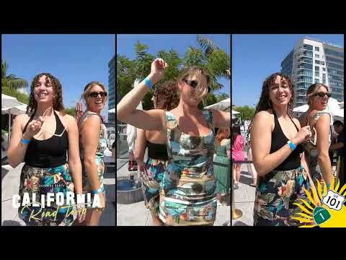
https://sites.google.com/view/fountain-valley-gifphoto-booth/home

Slide 17
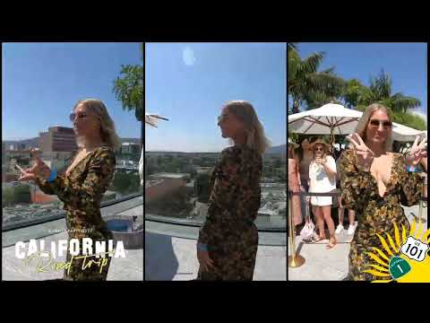
https://sites.google.com/view/fountain-valley-gifphoto-booth/home

Slide 18
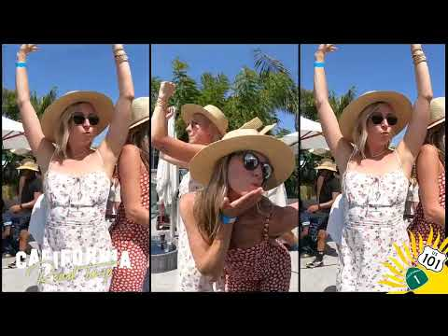
https://sites.google.com/view/fountain-valley-gifphoto-booth/home
Notes:
https://sites.google.com/view/fountain-valley-gifphoto-booth/home
https://drive.google.com/drive/folders/1zrvrdIRXyzdlfDJxCPtaR8q9Pu7VZbIs?usp=sharing
https://news.google.com/rss/search?q=photobooth
https://drive.google.com/drive/folders/1XvxE0FbB-HWhtAolzJ9ED_1PxTrMWh97?usp=sharing
https://drive.google.com/drive/folders/1KLHpJv8wV0FJsMxSF01gyxesEx-Ngi00?usp=sharing
https://drive.google.com/drive/folders/1TTQbDRxpm7FkB9mTjW-gJxc0MbcVMhZp?usp=sharing
https://drive.google.com/drive/folders/1VRKHoZmvOtkQ9v_956VlQO6V1e4XH1VC?usp=sharing
https://drive.google.com/file/d/1CRkk8lGsYTg1PzAsDBLamtOAmjsYaiuu/view?usp=sharing
https://drive.google.com/file/d/1XGhASpQL_fPrLbpGIgP8lRk5VUhK9uY9/view?usp=sharing
https://drive.google.com/file/d/1kPcxEfysqhBbJOKDz2ktCHvI5z5Ej-bO/view?usp=sharing
https://drive.google.com/file/d/1bNHd3WjeHgwLwcqTghDfPBmYkoQtOru2/view?usp=sharing
https://docs.google.com/spreadsheets/d/1GlP1QB_iQOmaGa11xuqtpEbntpeeApEEEOZ43NnSl-Q/edit?usp=sharing
https://docs.google.com/spreadsheet/pub?key=1GlP1QB_iQOmaGa11xuqtpEbntpeeApEEEOZ43NnSl-Q
https://docs.google.com/spreadsheets/d/1GlP1QB_iQOmaGa11xuqtpEbntpeeApEEEOZ43NnSl-Q/pubhtml
https://docs.google.com/spreadsheets/d/1GlP1QB_iQOmaGa11xuqtpEbntpeeApEEEOZ43NnSl-Q/pub
https://docs.google.com/spreadsheets/d/1GlP1QB_iQOmaGa11xuqtpEbntpeeApEEEOZ43NnSl-Q/view
https://docs.google.com/forms/d/1EL1wM0tDwrst4OxwxEYsKT0JnelIL9jMQI0qtPlF3kI/edit?usp=sharing
https://docs.google.com/drawings/d/1b1DCH3WthiQyZ45YukHchI6EbugZnxkzQszRuLE9jsw/edit?usp=sharing
https://drive.google.com/file/d/1Ub_baxN1yIKa7z6PHbWKiQ5Hv3QmkYdb/view?usp=drivesdk
https://sites.google.com/view/aitransformphotobooth/home
https://docs.google.com/document/d/1iSF2uFyDFbaBd0cOwU-1ZujMhTIJ5Bs6FFkXXtW7YMI/edit?usp=sharing
https://docs.google.com/document/d/1iSF2uFyDFbaBd0cOwU-1ZujMhTIJ5Bs6FFkXXtW7YMI/pub
https://docs.google.com/document/d/1iSF2uFyDFbaBd0cOwU-1ZujMhTIJ5Bs6FFkXXtW7YMI/view
https://docs.google.com/presentation/d/1bO48_2bW8zg7WEQbWgTwLlyWIaU3s__7BnTLNEhINs4/edit?usp=sharing
https://docs.google.com/presentation/d/1bO48_2bW8zg7WEQbWgTwLlyWIaU3s__7BnTLNEhINs4/pub?start=true&loop=true&delayms=3000
https://docs.google.com/presentation/d/1bO48_2bW8zg7WEQbWgTwLlyWIaU3s__7BnTLNEhINs4/view
https://docs.google.com/presentation/d/1bO48_2bW8zg7WEQbWgTwLlyWIaU3s__7BnTLNEhINs4/htmlpresent

Slide 19
Roaming photo booth rental fountain valley
https://sites.google.com/view/fountain-valley-gifphoto-booth/home
Notes:
Roaming photo booth rental fountain valley

